Slide 1


Bank of Baroda Hackathon - 2022
Technology Partner
Your Team Name : Cognitive Crew
Team bio : With four members and a base in Madurai, Tamil Nadu, Team Cognitive Crew is a hackathon-experienced team. The Thiagarajar College of Engineering nominated this team, which is the youngest and the only one with team members who are all in their first years, to compete in the Grand Finale of the Smart India Hackathon in 2022.
Date : 20/09/2022

Slide 2
Problem Statement?
According to an Association for Financial Professionals report, processing 20,000 checks each month may cost a business up to $30,000.
The survey found that receiving a paper check costs five times as much as ACH.
To address this problem, we are creating a highly effective, multilingual, rule-based programme that can automate the verification of the checks' technical details and signatures.
We selected this issue over others mostly because all of our members have experienced it, having to wait in line for a very long period to transfer money via a check.
Moreover, we believe our solution has the ability to reduce global warming by completely eradicating the use of paper cheques.

Slide 3
User Segment & Pain Points
We anticipate that large banks will adopt our solution after all micro, small, and medium-sized banks with low currency value transactions.
This is because, according to a survey by the Association for Financial Professionals, processing 20,000 checks each month might cost up to $30,000, which has a negative impact on company profitability.
We estimate that, when compared to using a normal production infrastructure, our approach can cut processing time by 15-20 cheques per second and up to 55% in processing costs.

Slide 4
Pre-Requisite
PAY SIMPLE:
This app simplifies billing and collection processes by enabling bill , collect and deposit of payments automatically which also includes recurring bill, electronic check processing, direct debit and credit card processing at some of the lowest rates
EMB:
  Faster funding app. In addition to specializing in high-risk merchant accounts, EMB offers personalized payment solutions that allow new and established merchants to succeed. Electronic check processing service applications are approved in 24 to 48 hours. Once approved, EMB can set up a payment gateway and fraud filters. Money is transferred from one entity to another but without any actual paper exchanging hands. This makes faster and cheaper .

Slide 5
Azure tools or resources
For various operations, our team has planned to leverage a range of Azure products, including:
Computer Vision and Custom Vision – To be used for analyzing the content in images
  Vision Studio – To be used for integrating features from Azure Computer Vision
  Azure Active Directory – To be used for Role-Based Access Control (RBAC)
  Cosmos DB – To be used as primary Database
  Azure Blob storage – To be used to store unstructured data

Slide 6
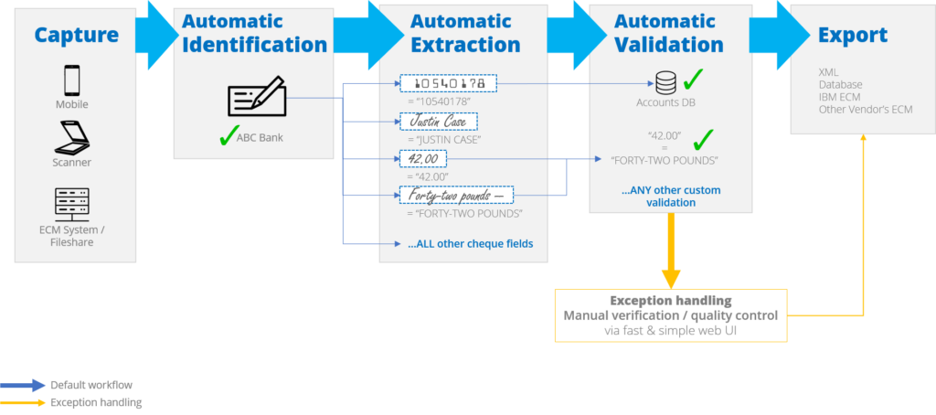
Supporting Functional Documents
The workflow of our product is detailed in the diagram above. To bring our offering to reality, we will use a variety of Azure tools and ECM from other suppliers.

Slide 7
Key Differentiators & Adoption Plan
Our module has improved the effectiveness of processing enormous amounts of checks as compared to Arya’s.
Each model calculates a confidence level for its field value prediction.
Numerous business level validations are applied after applying these confidence scores, and a significant number of checks are cleared with little to no human involvement.
Additionally, a highly accurate signature verification approach aids in lowering the incidence of fraud.
The amount must match the amount in figures and words. The date on the check must be less than 90 days from the present date.
The signature on the check must be highly confidently matched to the signature in the relevant account's core banking database.
These will be what sets us apart most.

Slide 8
Thank You
Santhosh KMR, Sophomore, Thiagarajar College of Engineering,
Thiyagarajan S, Sophomore, Thiagarajar College of Engineering,
Vasikaran K, Sophomore, Thiagarajar College of Engineering,
Vineesha V, Sophomore, Thiagarajar College of Engineering,

